Slide 1


INDIA’S LARGEST ED-TECH COMPANY
BYJU’S
FYIT_120_ KRITI

Slide 2
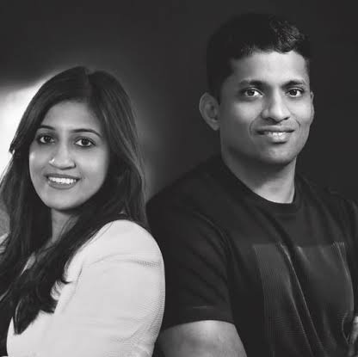
FOUNDERS BYJU RAVEENDRAN (CEO) DIVYA GOKULNATH (CO-FOUNDER & DIRECTOR)
Founded : Bengaluru
‘ 11 , 11 Years ago
Revenue: 2,800 Crores INR (US$390 million, 2020)
Headquarters: Bengaluru, Karnataka, India
Area served: Worldwide

Slide 3
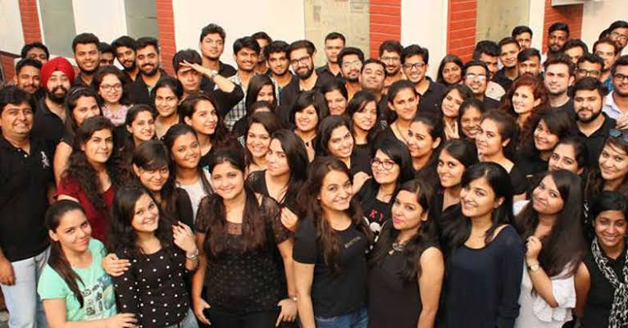



Introduction
BYJU'S is an Indian multinational educational technology company, headquartered in Bangalore. It was founded in 2011 by Byju Raveendran and Divya Gokulnath. as of December 2021, BYJU'S is valued at US$18 billion and has over 115 million registered students.

Slide 4

BYJU'S' app was developed by Think and Learn Pvt. Ltd, a company which was established by Byju Raveendran, Divya Gokulnath and a group of students in 2011. Byju, an engineer by profession was coaching students in mathematics since 2006. In initial days The company focused on offering online video-based learning programs for the segment and for competitive exams. In 2012, the firm entered Deloitte Technology Fast 50 India and Deloitte Technology Fast 500 Asia Pacific ratings and has been present there ever since. In August 2015, the firm launched BYJU'S: The Learning App.[ In 2017, they launched BYJU'S Math App for kids and BYJU'S Parent Connect app. By 2018, it had 15 million users out of which 900,000 were paid users at that time. In the same year, BYJU'S became India’s first edtech unicorn. By 2019, 60% of BYJU’S students were from non-metros and rural cities. In July 2019, BYJU'S won the sponsorship rights for the Indian cricket team jersey. In January 2022, the company joined Simplilearn, Unacademy, upGrad, and Vedantu to become one of the founding members of IAMAI's India EdTech Company.

Slide 5
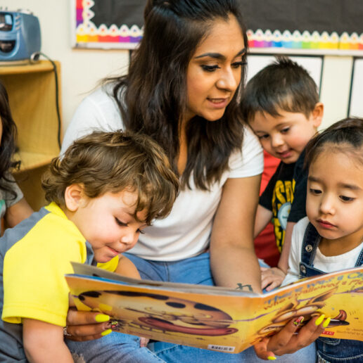
BYJU’S proven academic methodology
Designed to deliver results
Every class is carefully designed by experts with methods that are proven to give results
Classes structured to learn- practice-revise
Classes are structured to help students not just learn concepts but also practice and revise them
Tests, quizzes and worksheets
Tests, quizzes and worksheets for better practice and retention
Book a FREE Class

Slide 6
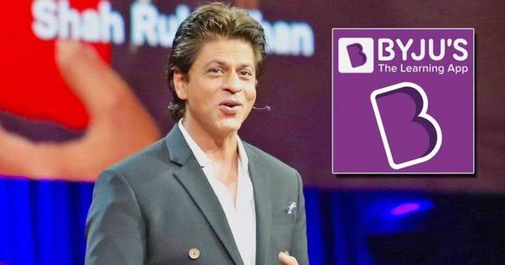
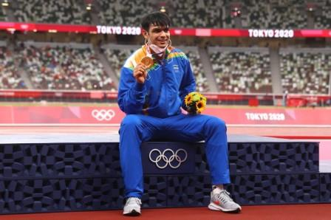

BRAND AMBASSADORS
SHAHRUKH KHAN
(ACTOR)
NEERAJ CHOPRA
(OLYMPICS GOLDMEDLIST)
MAHESH BABU
(ACTOR & BUSINESSMAN)

Slide 7
BYJU’S…................................
Education FOR ALL
BYJU'S is an education tutoring app that runs on a freemium model, with free access to content limited for 15 days after the registration. It was launched in August 2015, offering educational content for students from classes 4 to 12 and in 2019 an early learning program has started for classes 1 to 3. It also trains students for examinations in India such as IIT-JEE, NEET, CAT, IAS, and international examinations such as GRE and GMAT.
Academic subjects and concepts are explained with 12-20 minute digital animation videos.^{[24][25][26]} BYJU'S reports to have 4 crore (40 million) users overall, 30 lakh (3 million) annual paid subscribers and an annual retention rate of about 85%.^{[27][28]} In 2019, the company announced that it would launch its app in regional Indian languages.^{[29][14]} It also planned to launch an international version of the app for English-speaking students in other countries.^{[30][31]} Recently, Byju's launched new programs in its Early Learn App for students of kindergarten as well.^{[32]} In April 2021, the company also announced the launch of "BYJU'S Future School" to be led by WhiteHat Jr Founder Karan Bajaj. The Future School aims to cross the bridge from passive to active learning with an interactive learning platform blended with coding and other subjects like Math, Science, English, Music and Fine arts through storytelling. BYJU'S will launch the Future School in the United States, United Kingdom, Australia, Brazil, Indonesia and Mexico in May.

Slide 8


Thank You
Email address : support.contact.byju’s@gmail.com
Website address: www.byju’s.com

